Slide 1
Trigger in SQL
Trigger: A trigger is a stored procedure in database which automatically invokes whenever a special event in the database occurs. For example, a trigger can be invoked when a row is inserted into a specified table or when certain table columns are being updated.

Slide 2
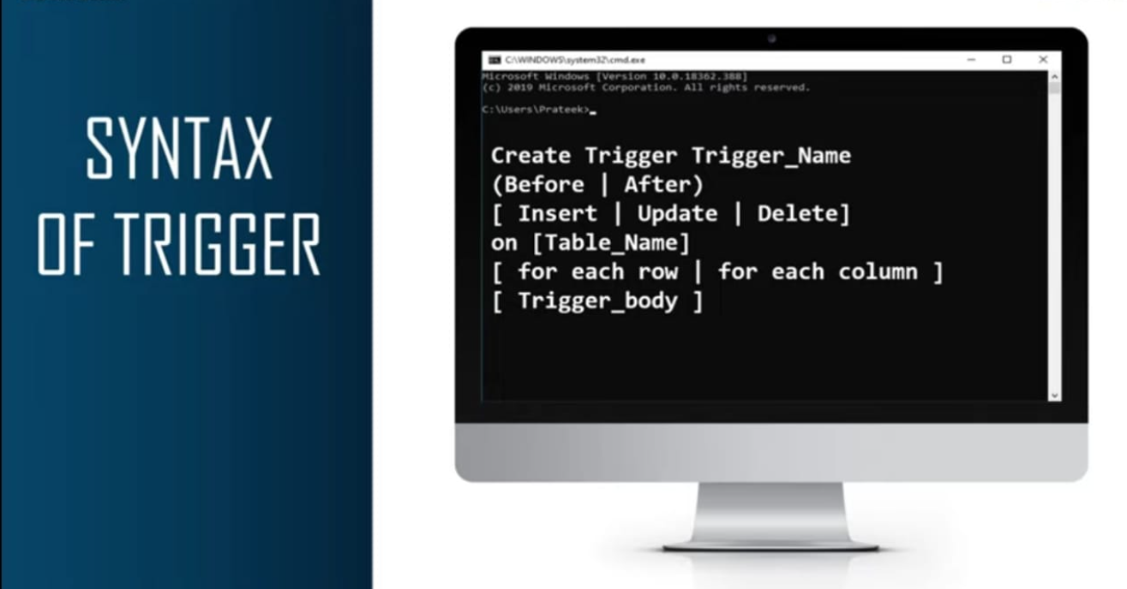

Slide 3
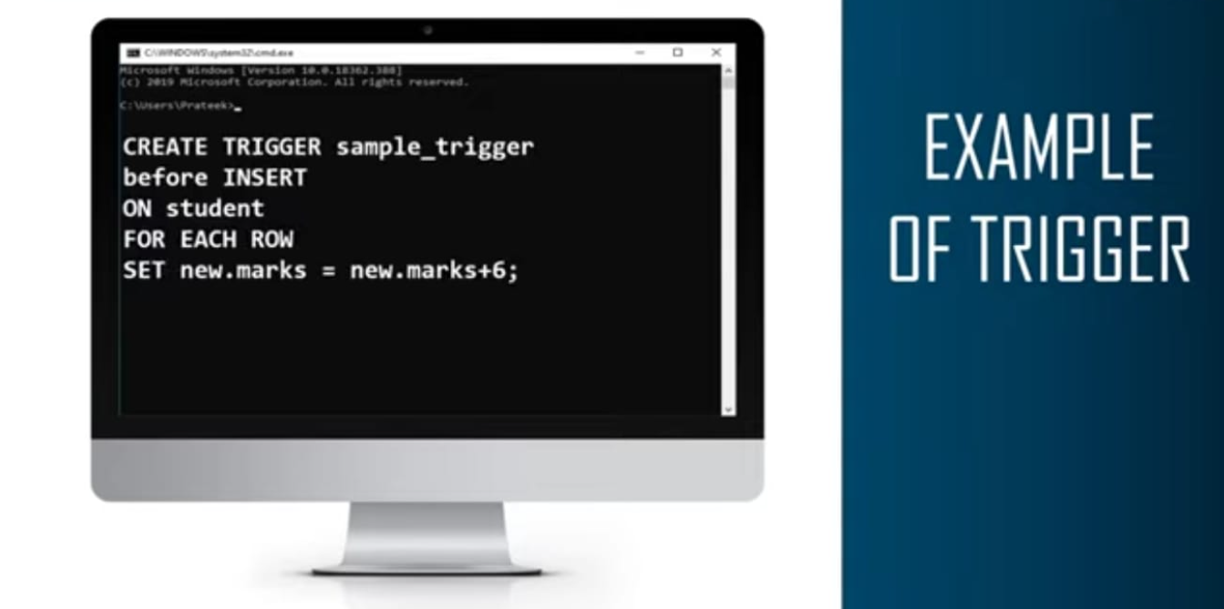

Slide 4
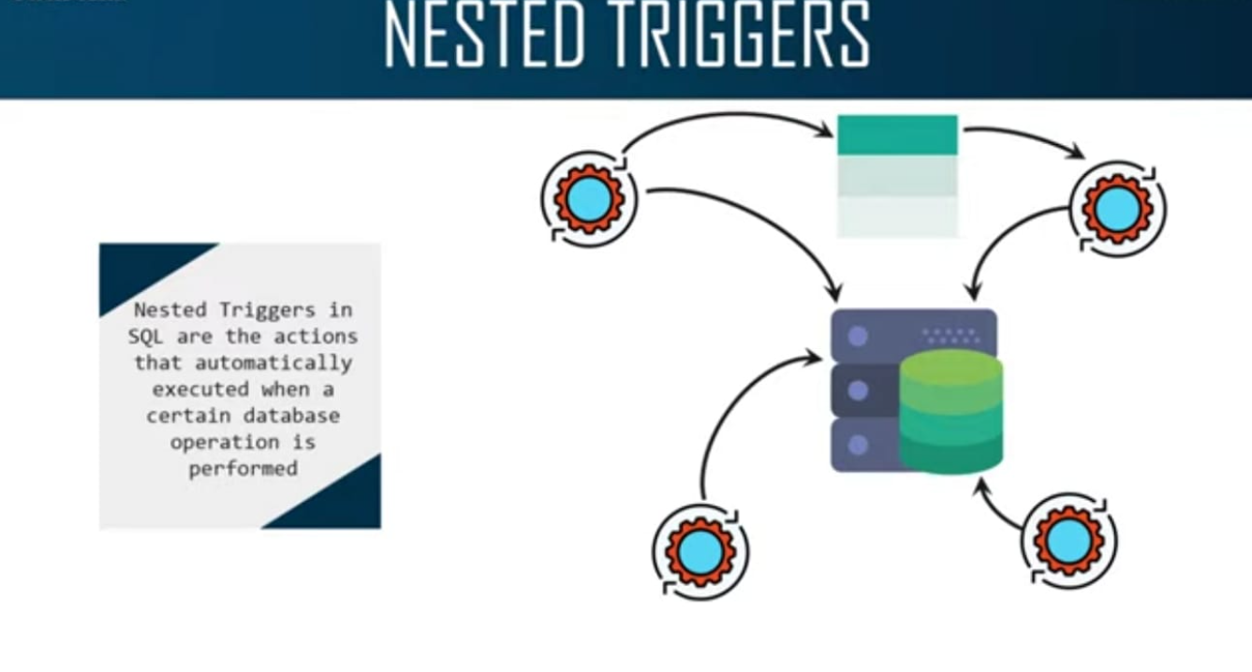

Slide 5
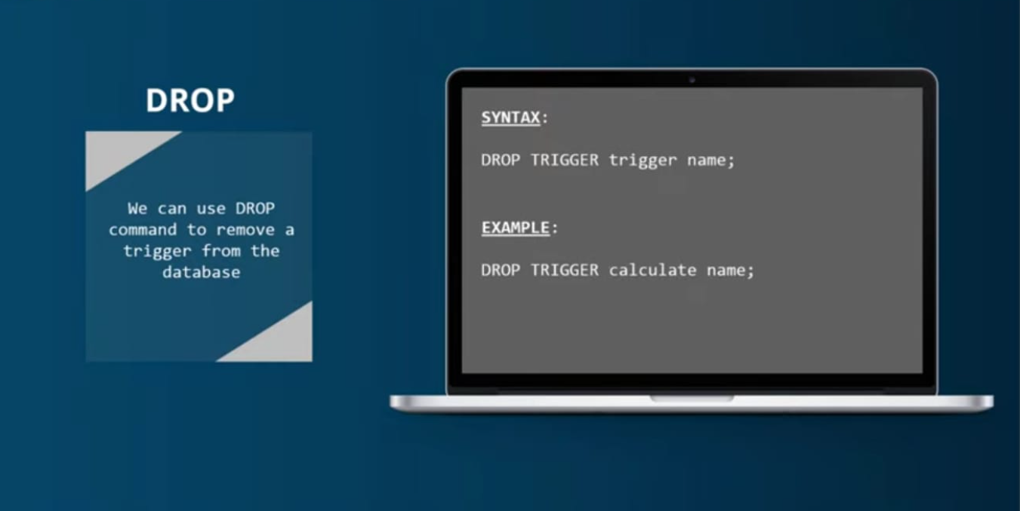

Slide 6
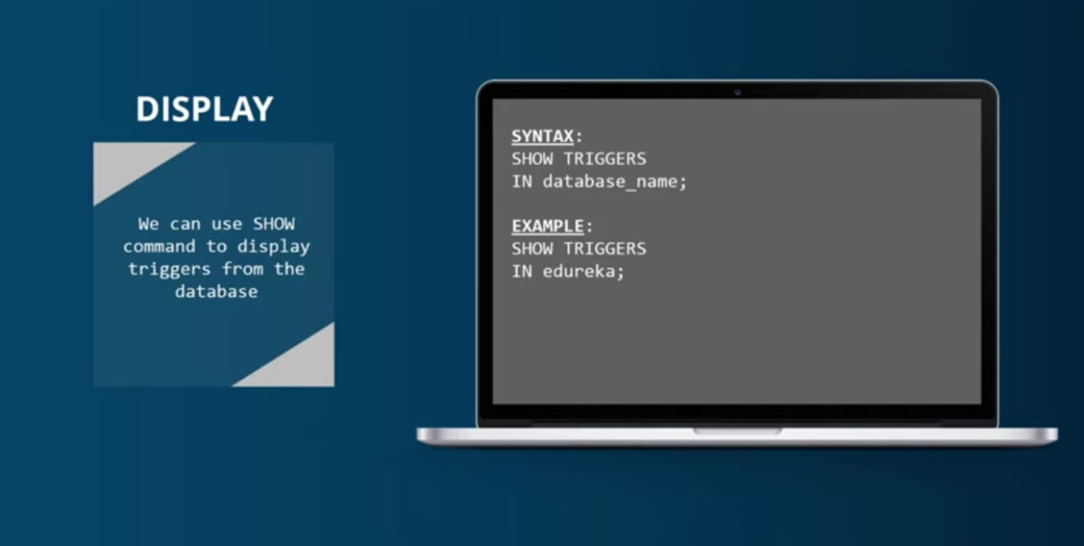

Slide 7
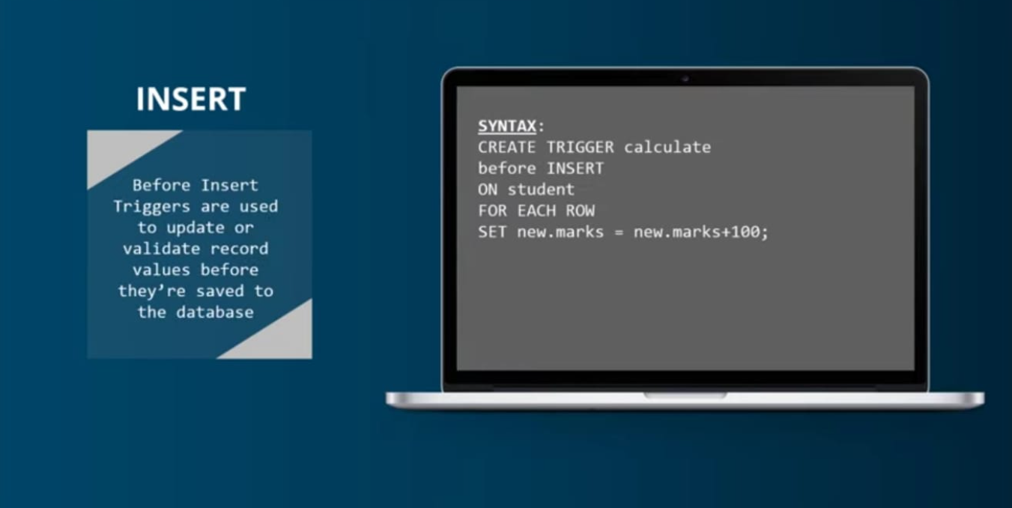

Slide 8
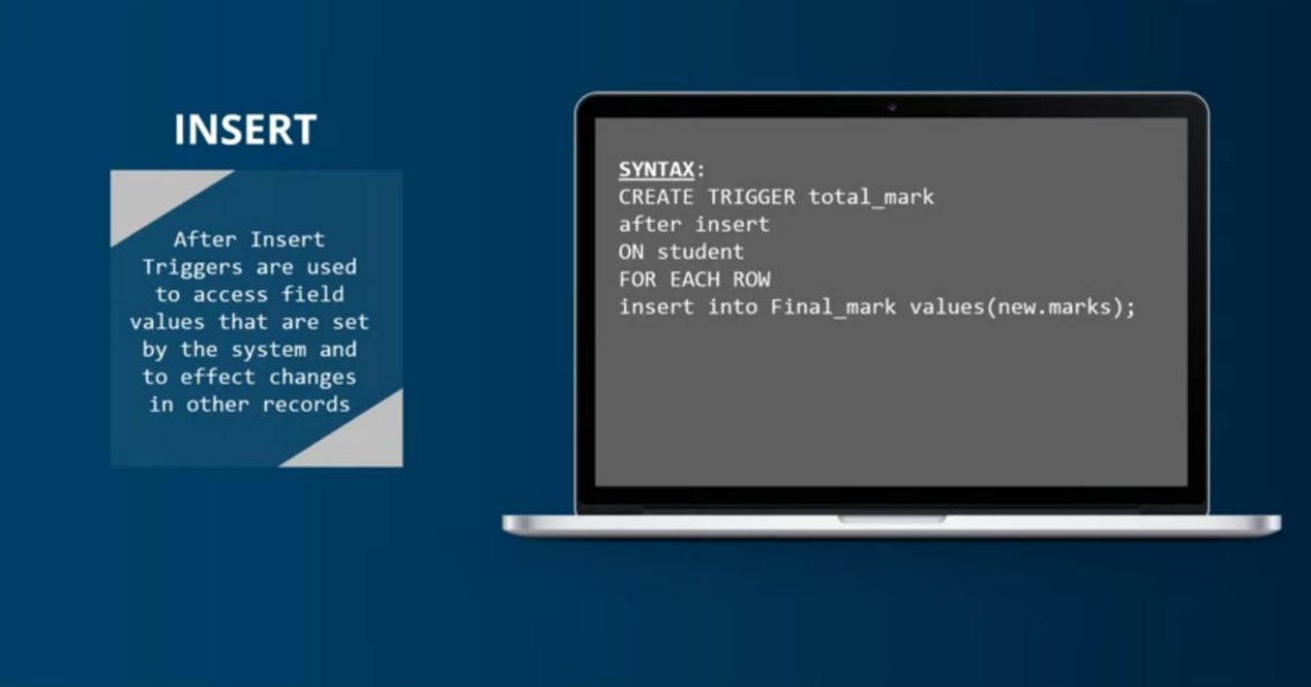

Slide 9
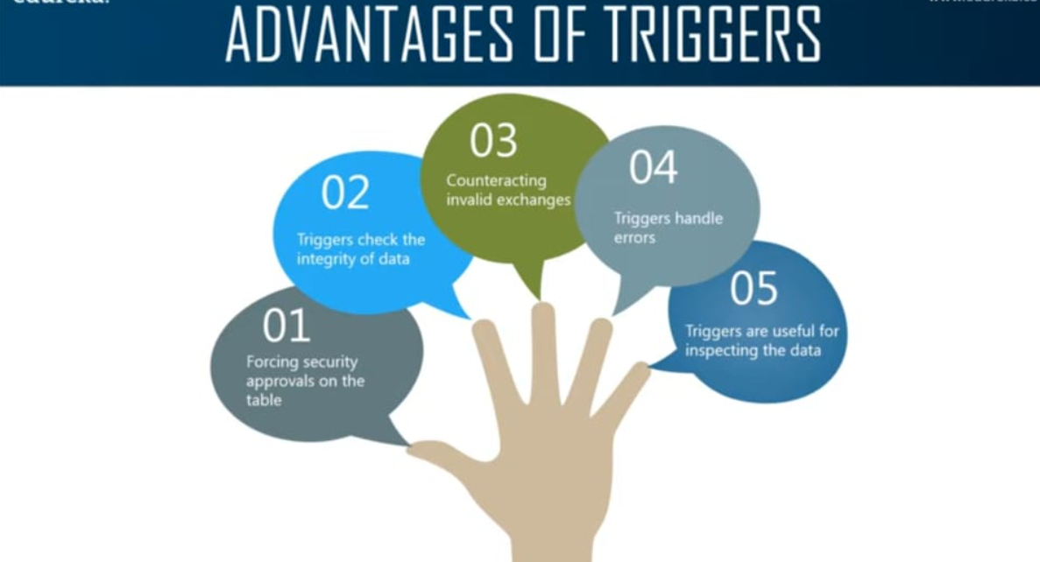

Slide 10
